Slide 1
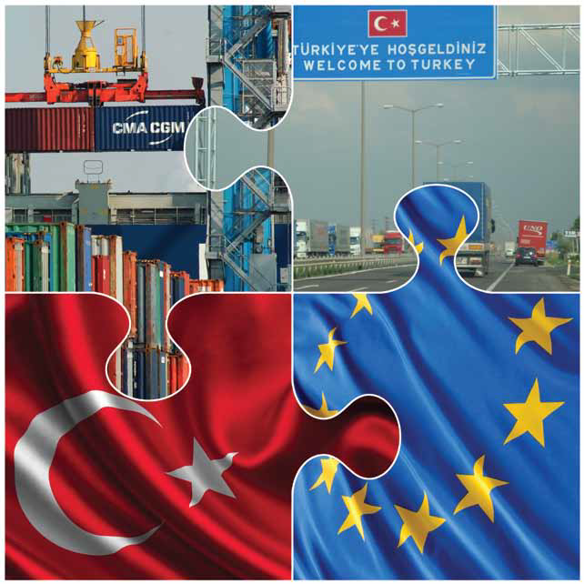
Evaluation of the
EU-TURKEY Customs Union by the World Bank
33rd Meeting of the
EU-Turkey JCC
June 20, 2014
İzmir

Slide 2
Key Messages
CU has unfulfilled potential: reformed & deepened arrangement would bring gains
Recommendations can be taken up one-by-one or as a package
A potential package might include:
  Reducing asymmetries in the decision making process
  Formalizing parallel negotiations for FTAs
  Green lane for visas for pre-qualified Turkish professionals
  Liberalizing road transport permits on trade covered by the CU
  Better coordinating before trade defense instrument investigations launched
  Widening preferential trade to primary agriculture and services
  Strengthening dispute settlement
  Increasing transparency in Turkey’s transposition of the acquis

Slide 3
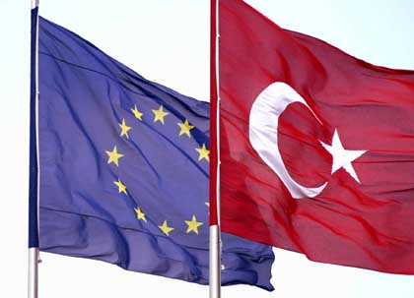
Objectives of the evaluation
1) To assess the economic impacts of the CU
2) To make forward-looking, solution-orientated policy recommendations to improve the EU-Turkey trade relationship

Slide 4
Key finding 1
The CU has brought greater benefits than an FTA
The common external tariff has anchored Turkey’s import tariffs
Costly rules of origin are not needed
Turkey’s exports to EU 7% higher under a CU than an FTA
EU exports to Turkey are 4% higher
Most affected sectors: motor vehicles, televisions, clothing

Slide 5
Key finding 2
Widening the agreement to primary agriculture would bring benefits to both parties
Adopting the CET significantly decreases Turkey’s import protection
  ⇒ Lower prices for consumers but also lower farm employment in Turkey
EU-Med countries face increased competition from oils and tomatoes
EU animal product exports to Turkey increase
Assumes Turkey can meet EU rules on food safety
  ⇒ €2 billion required to modernize firms in dairy, meat, livestock & fish

Slide 6
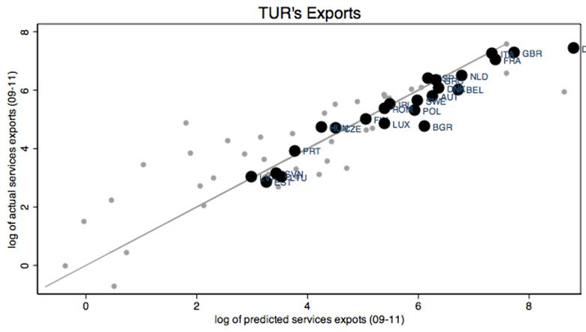
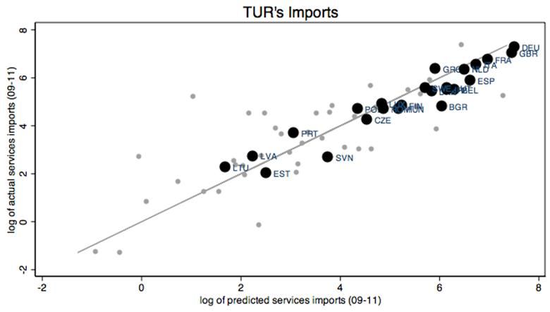
Key finding 3
Including services would boost trade
Gravity model of Turkey’s services trade with the EU, 2009-11
Model estimates suggest static gains of US$1.1 billion for Turkey opening cross-border services trade
Main differences in regulatory regimes are retail; transportation (EU more restrictive) & professional services; rail (Turkey more restrictive)

Slide 7
Key finding 4
Bilateral opening of public procurement would bring gains
PP in Turkey accounts for 7% of GDP
Since 2003, PP Law has been developed to align with the acquis in context of accession negotiations
However limits to foreign competition / potential EU contractors remain:
  While most tenders are open, exclusions & exemptions are used (0.5% of GDP)
  Foreign competition is also limited as a result of domestic price preferences
  PP threshold is twice that of the EU

Slide 8
Key finding 5
Correct asymmetries to maximize gains
Turkey has obligation to align with EU legislation but cannot participate in decision making in areas related to CU
Provisions on institutional cooperation & decision shaping have not been properly implemented: increases risk of non-compliance
First best solution would be to move forward with accession negotiations
In the meantime improve information/consultation sharing mechanisms to reduce impact of asymmetries
  E.g. establish ‘Friends of Turkey’ working groups; greater representation on comitology committees

Slide 9
Key finding 6
Formalize parallel negotiations for FTAs
Some EU FTAs have not been concluded with Turkey (e.g. Algeria, RSA, Mexico)
EU FTAs with US etc. risk larger potential losses for Turkey
  Limits Turkish market access
  Erodes Turkish preferences in the EU market
  Creates trade deflection (that could necessitate ROOs)
Parallel track negotiations mirroring the main EU negotiations that start & conclude at the same time could resolve the problem
But Turkey must also be ready to negotiate to a standard of comprehensiveness e.g. services, agriculture, regulations

Slide 10
Welfare effects of finalizing non-compliant FTAs for Turkey

Slide 11
Key finding 7
Formal mechanism needed to ensure transparency in Turkey’s transposition of the acquis
With some exceptions, Turkey has aligned to the acquis in areas covered by the CU
  As of 2010, 85% according to the Turkish Ministry of EU Affairs
  However the Commission has not been able to verify the transposition
Important since exported products to the EU are assumed to comply with all technical regulations if the acquis has been adopted
Lack of harmonization in select Old Approach directives & risks from continued harmonization
Process of transposition is also outdated: last list issued in 1997
Formal mechanism needed to keep track of stock of EU legislation & status of transposition to reduce the ‘notification deficit’

Slide 12
Key finding 8
Implement functioning dispute settlement mechanism
Existing DSM limited to disagreements on duration of safeguards
Improved DSM would rebalance market access obligations and resolve various trade irritants
A DSM where one party can bring a case on a broader range of disputes would be more effective
To facilitate implementation, simultaneously reduce asymmetries in decision making

Slide 13
Key finding 9
Reduce trade costs for continued growth in trade
Road transport permits—especially for transit—should be liberalized at least for goods covered by the CU
  Commission could receive a mandate to negotiate: i) transport services; or ii) road transit agreement (Hungary and Romania); or iii) road transport agreement (Switzerland)
  Transport Policy Chapter of the acquis could be opened
Establish a “Green Lane” for pre-qualified business people traveling to the EU on business to obtain long-term, multiple entry visas with simplified documentary requirements
Enhance dialogue before Trade Defense Instrument investigations are launched on EU-Turkey trade e.g. Early Warning System

Slide 14
Thank You.

Slide 15
RESERVE SLIDES

Slide 16
Simulated effects of deepening the EU-Turkey trade agreement in primary agriculture
a) Change in Turkish real income b) Change in EU real income
c) Change in Turkish farm employment
Measures to improve productivity could help offset negative effects
e.g. increased agricultural research

